Slide 1

NETWORK DESIGN FOR ANTHONY'S POTATO CHIP COMPANY
Submitted to: Sir Imran Ahmad
Course: Data communication & networks
Team Members:
Bisma Qamar (Biet-F21-004)
Anas ABdullah (Biet-F21-006)
Khuzaima Faizan (Biet-F21-047)
Zunaisha Noor (Biet-F21-049)

Slide 2
Overview
Introduction
Problem Statement
Configuration Steps
Subnetting
Conclusion

Slide 3
Introduction
Strategic Network Role: Highlights the pivotal role of a robust network as the foundation for organizational success in modern business.
Tailored to Company Needs: Addresses the specific needs of Anthony's Potato Chip Company, catering to seamless communication, data management, and accessibility for 500 employees across three locations.
Comprehensive Optimization: Proposes a comprehensive solution by analyzing existing networks, anticipating future needs, and optimizing information flow and productivity.
Future-Ready Design: Emphasizes adaptability to future technological advancements and business expansions, ensuring the network's long-term viability.
Holistic Approach: Covers diverse aspects, from data types to software recommendations, reflecting a well-rounded and tailored network design strategy.

Slide 4
Problem Statement
Anthony's Potato Chip Company is dealing with an old and ineffective computer network that's causing a lot of problems. The main issues are in the main office and the production facility, where outdated technology is causing frequent breakdowns and putting data at risk. Now, with a new Sales Office in Escondido on the way, the problems are getting worse, and the company needs a network that can handle its growth. There are problems with slow data transfer, not enough storage space, and the network doesn't prioritize important tasks. To stay competitive, work together better, and smoothly add new locations, Anthony's Potato Chip Company needs to fix these issues and update its network.

Slide 5
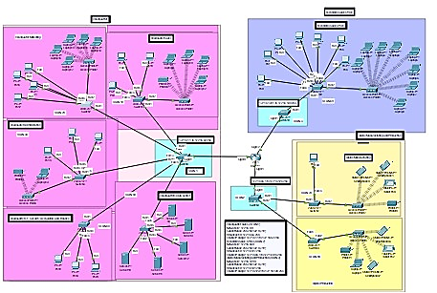
Configuration Steps
Interface all the routers and Switches
SSH on all Routers and switches
Vlan Assign with access port and trunk port
Subnetting and IP address
RIP on routers and switches
Inter vlan routing on switches plus ip dhcp helper address
Wireless network configuration
PAT + Nat + ACL
Verify and Testing Configuration

Slide 6
Subnetting (3 Departments)
Base Network: 172.16.0.0 | Subnet-Mask of Class C = 255.255.0.0
No. of subnets = 3 | New Subnet-Mask of Class C = 255.255.192.0
VLAN | Subnet | Network ID | Subnet Mask | Broadcast ID | Usable IP Range
1 | Head Sales | 172.16.0.0 | 255.255.192.0 (/18) | 172.16.63.255 | 172.16.1.1 to 172.16.62.254
2 | Escondido Sales | 172.16.64.0 | 255.255.192.0 (/18) | 172.16.127.255 | 172.16.65.1 to 172.16.126.254
3 | Alpine Mfg. | 172.16.128.0 | 255.255.192.0 (/18) | 172.16.191.255 | 172.16.129.1 to 172.16.190.254

Slide 7
Conclusion
Infrastructure Upgrade: Proposes a strong solution to upgrade outdated infrastructure for current needs and future growth.
Comprehensive Design Framework: Includes a detailed plan for data management, communication, and teamwork.
Cisco Products Integration: Highlights the strategic use of Cisco products for enhanced reliability.
Collaboration Software: Emphasizes the implementation of software to improve communication and teamwork.
Structured Implementation: Outlines a structured approach through methodology, work division, and milestones for successful implementation

Slide 8
Any questions ???☺

